Slide 1
🔓
File Unblocker​ Utility
Quickly unblock files and remove Windows file blocking restrictions.
Presented By: Satyasri Anumolu
Date: September 2026

Slide 2
Files downloaded from external sources (email, Teams, SharePoint, internet) are often marked as blocked by Windows security.
Users must manually unblock each file through File Properties, which is time-consuming.
Large numbers of blocked files lead to repetitive manual effort and reduced productivity.
Non-technical users may not know how to unblock files, resulting in support requests.
Blocked files can prevent scripts, executables, and documents from functioning as expected.
Business Problem

Slide 3
Developed a File Unblocker Tool to automate the file unblocking process.
Provides a simple and intuitive user interface for easy operation.
Enables users to select and unblock files with a single click.
Automatically removes Windows security block attributes from downloaded files.
Eliminates the need for manual navigation through file properties.
Displays real-time status and operation results to users.
Reduces processing time and repetitive manual effort.
Improves productivity by providing quick access to blocked files.
Ensures a consistent and efficient file unblocking experience.
Select Files/Folder →Scan Files → Detect Blocked Files → Bulk Unblock → View Results
Solution/
Approach

Slide 4
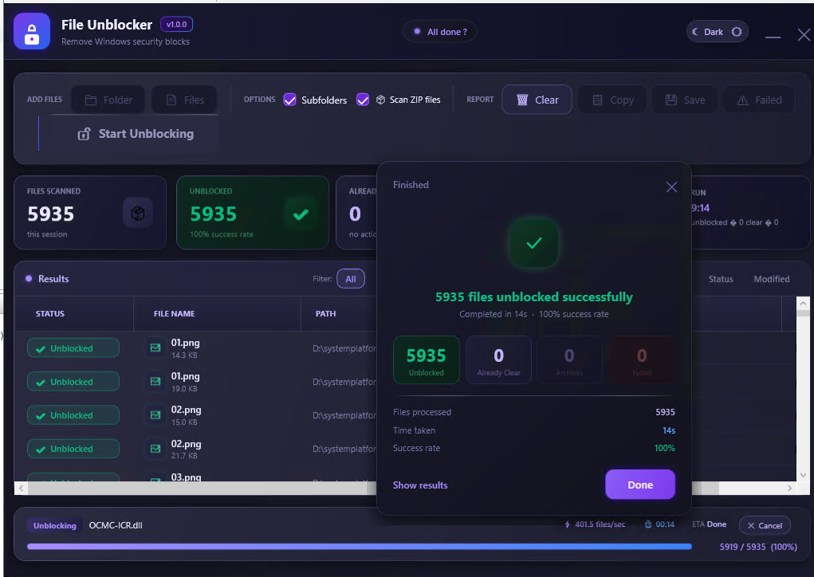
Tool view

Slide 5

Manually unblocking 5,935 files could take several hours. Using the File Unblocker Utility, the same task was completed automatically in just 14 seconds, achieving a 100% success rate and significantly reducing manual effort.
Measured Productivity Improvement

Slide 6
Select files or folders that need to be unblocked.
Scan subfolders automatically to find all blocked files.
Unblock multiple files in bulk with a single click.
Scan ZIP files and process supported files within them.
View real-time progress while files are being processed.
Review results with scanned, unblocked, already-clear, and failed file counts.
Save or copy results for further validation and tracking.
Tool use

Slide 7
Saves Time: Unblocks multiple files in bulk instead of manually unblocking each file.
Easy to Use: Simple UI allows users to select files or folders and start unblocking with one click.
Handles Large Volumes: Processes thousands of files quickly and efficiently.
Complete Coverage: Supports subfolders to ensure all applicable files are processed.
Improves Productivity: Reduces repetitive manual effort during setup and validation activities.
Clear Results: Provides a summary of successfully unblocked, already-clear, and failed files.
Flexible Usage: Supports both individual files and complete folders, including ZIP file scanning.
Benefits/
Advantages

Slide 8
Demo
August 2026

